Slide 1



An Efficient Transport Estimator for Complex Layered Materials
Luis E. Gamboa
Adrien Gruson
Derek Nowrouzezahrai
Notes:
In this video we present a method for rendering materials formed by layers with complex properties.
We designed an efficient, unbiased estimator that simplifies the computation of light transport throughput inside, and across, layers.

Slide 2
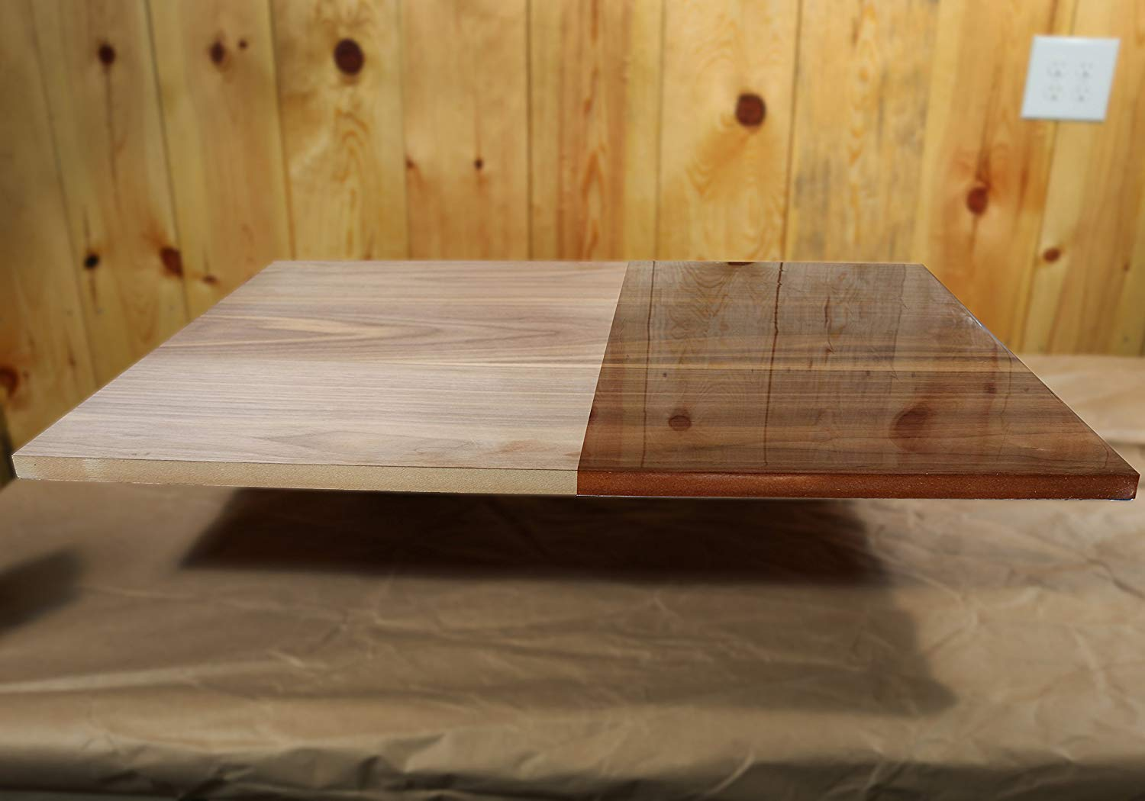
Epoxy on wood (photo)
Notes:
Many materials exhibit a layered nature.
In this photograph we can observe the appearance of wood before and after applying an epoxy coat.
This clear coat layer produces a finished smooth and glossy appearance on top of the rough and diffuse properties of wood.

Slide 3
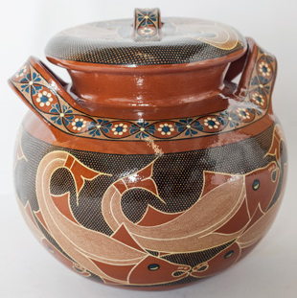
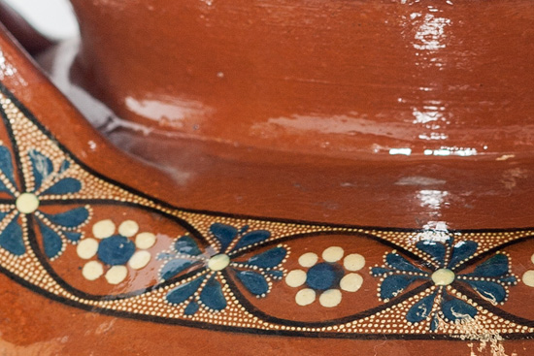
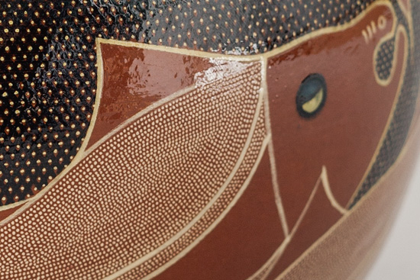
Dotted clay pot artwork photos (Capula, Mexico)
Notes:
Some artwork relies on layered configurations.
In this photographs we see the work made by artisans from Capula in Mexico.
A clay pot is carefully adorned with tiny colored dots creating a spatially varying medium layer before applying a varnishing coat with a glossy look that seals and preserves the material.

Slide 4
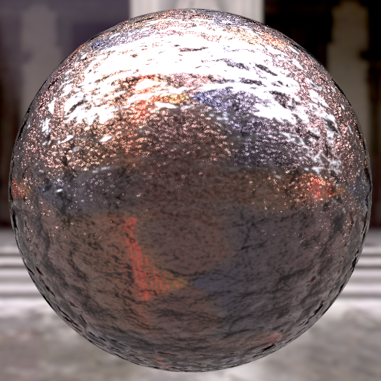
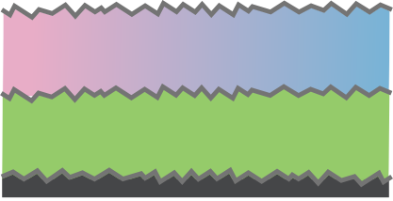
Dielectric (normal mapped)
Medium with spatially-varying properties
Dielectric
Anisotropic participating media
Conductor (normal mapped)
Notes:
A layered material is formed by stacking interfaces (defined by a BSDF) and participating media.
In this figure, we rendered a complex layered material that consists of
a base normal mapped metallic material,
coated with a colored anisotropic medium,
a dielectric interface,
a spatially varying medium
and a normal mapped dielectric interface.
Evaluating these type of materials using a simple combination of the individual profiles is not sufficient.
Instead, we must account for the full light transport that occurs inside the material.

Slide 5
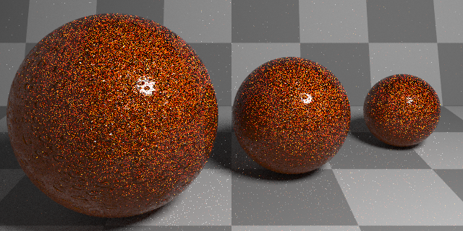
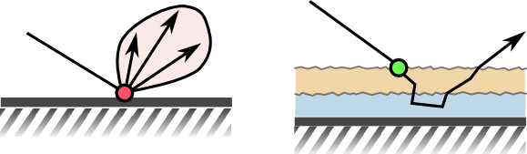
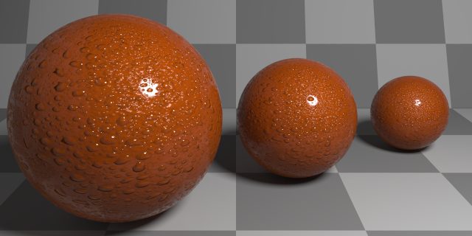
Use scene-level explicit geometry and path tracing
61 spp
Non-layered material
Layered material
Extremely inefficient!!!!
100k spp
Notes:
Even under a structured layered configuration, rendering these materials is challenging.
In this scene, we model a layered material using scene-level explicit geometry at three scales and render using path tracing.
Non-layered materials, like the checkered floor, need just a few samples to render correctly, but the layered material introduces high-variance that is only resolved using very high sampling rates.
And this process is not cheap, generating paths through the layered material requires repeatedly querying intersection acceleration structures since each layer is treated as an independent object.
Additionally, all layers are occluded by the top most interface, and as such, performing direct illumination operations on them is not possible.

Slide 6
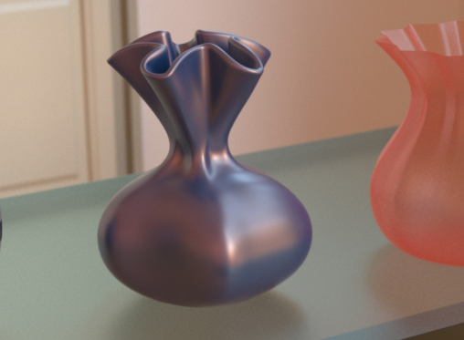
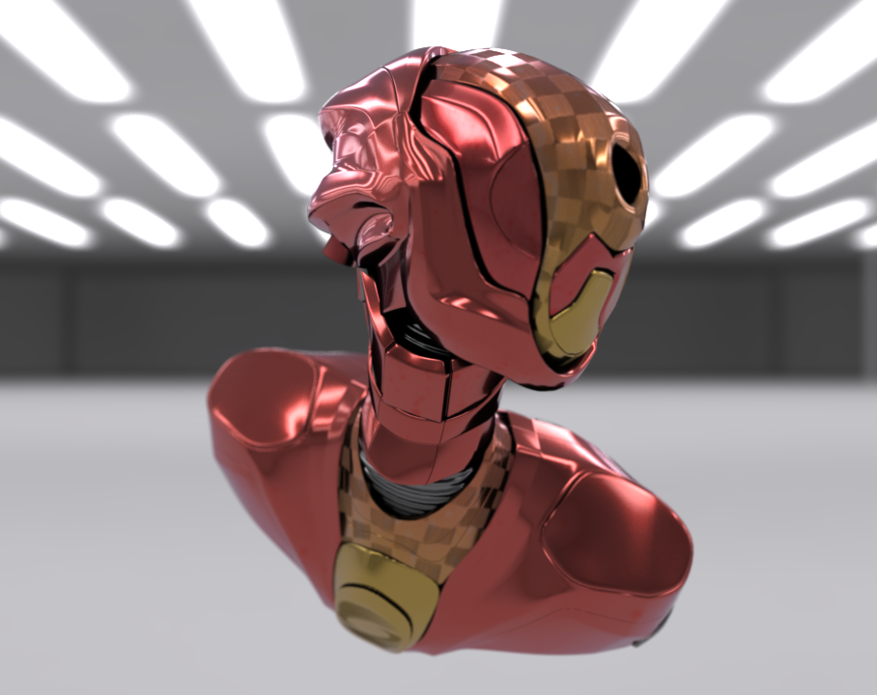
Jakob et al. 2014
Belcour 2018
Notes:
Prior work abstract the layered material and present it to the renderer as a single BSDF.
The work by Jakob and colleagues leverages a high performance method that relies on precomputed data for a fixed configuration. As such, support for spatially-varying properties is limited.
Belcour proposed a model to operate on light transport statistics, allowing his method to approximate the layered BSDF as a mixture of standard analytic glossy lobes.

Slide 7
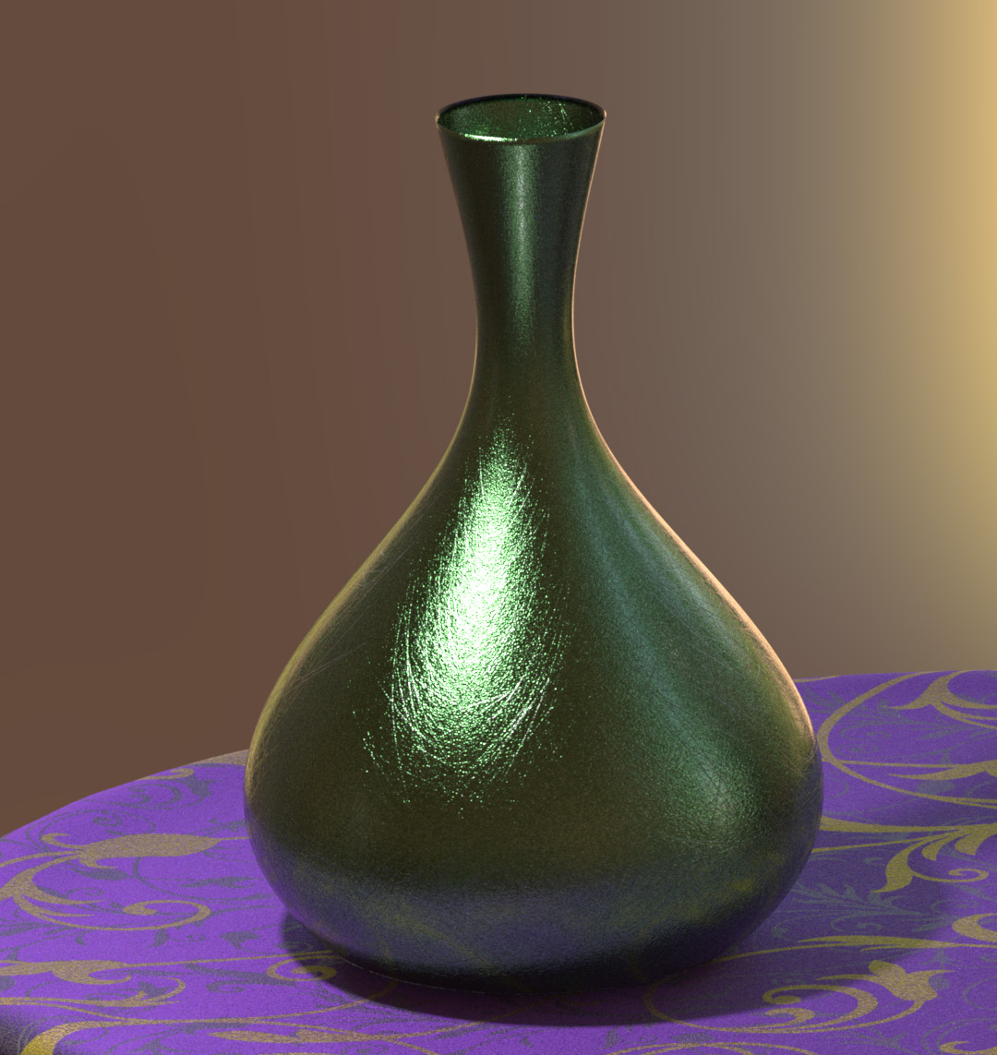
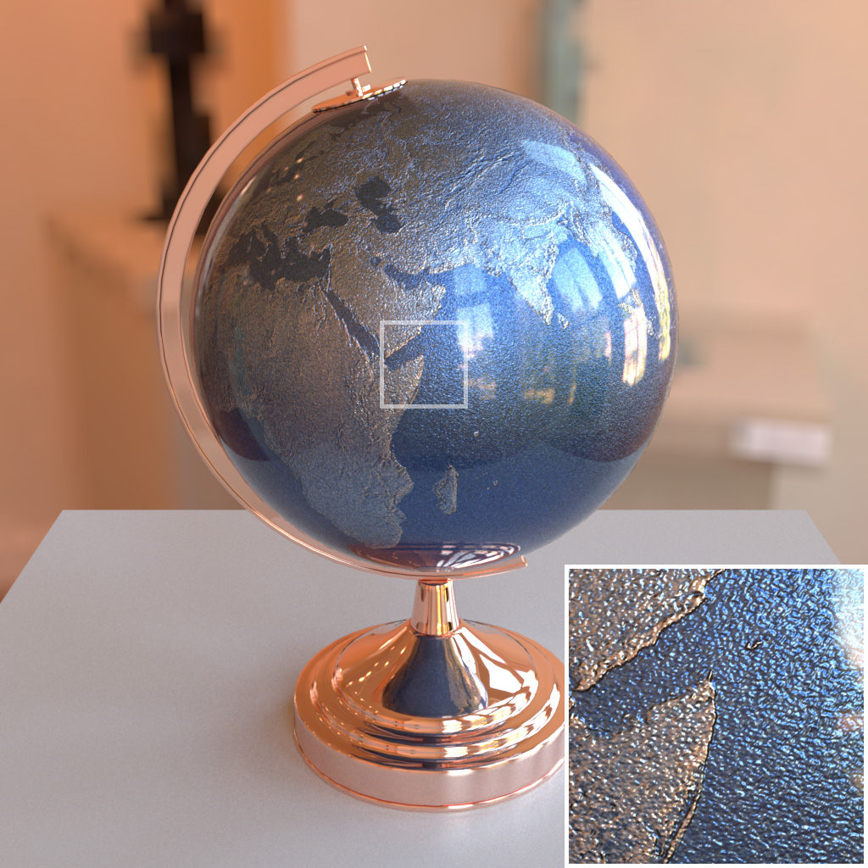
Guo et al. 2018
Notes:
The work of Guo and colleagues introduced the position-free simplification to the microscale layered path space.
This allowed to seamlessly incorporate arbitrarily spatially-varying properties, like normal maps and participating media coefficients, to all layers without relying on additional approximations or precomputed data.

Slide 8
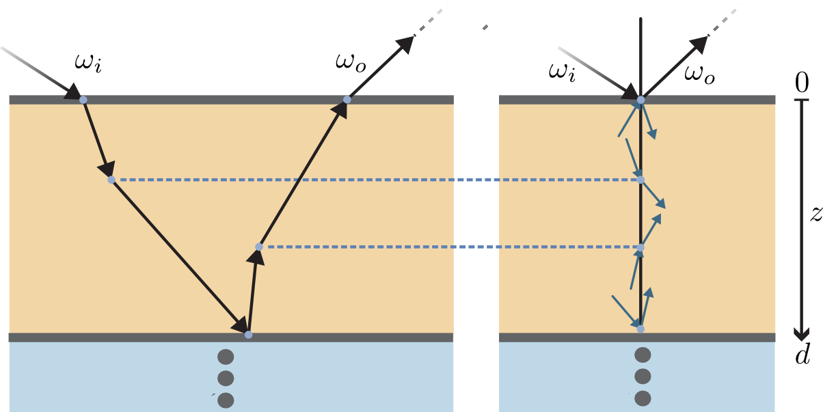
Position-free formulation (Guo et al. 2018)
Notes:
In the position-free formulation, path vertices are not represented by points in a three dimensional space, where path segments and directions are implicit.
Instead, each vertex is dependent on depth and direction and all events are located at the same horizontal position.

Slide 9
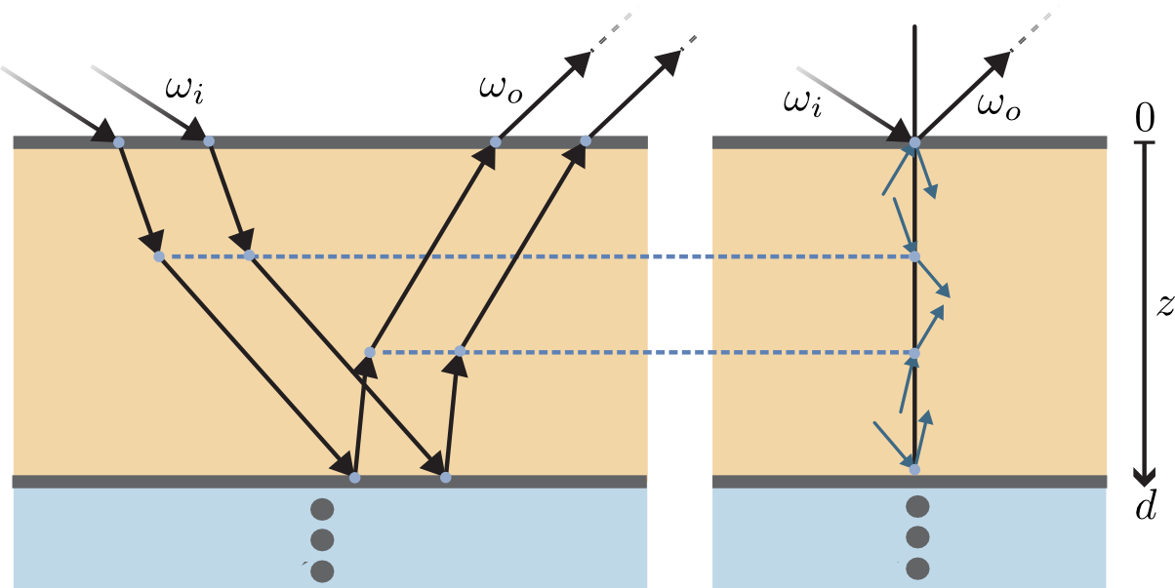
Position-free formulation (Guo et al. 2018)
Notes:
As such, this reparameterization collapses all tangentially-translated paths onto a single depth-direction configuration.
Eliminating the tangential spatial-variation simplifies a layered BSSRDF to a BSDF.

Slide 10
Evaluating a layered BSDF
Fixed directions
Space of paths that start and finish with those directions
Notes:
Evaluating the BSDF of the layered material involves solving at the layered microscale, the integral over the space of all paths that start and finish with fixed incident and outgoing directions.
This is a challenging problem that requires advanced light transport integration strategies.

Slide 11
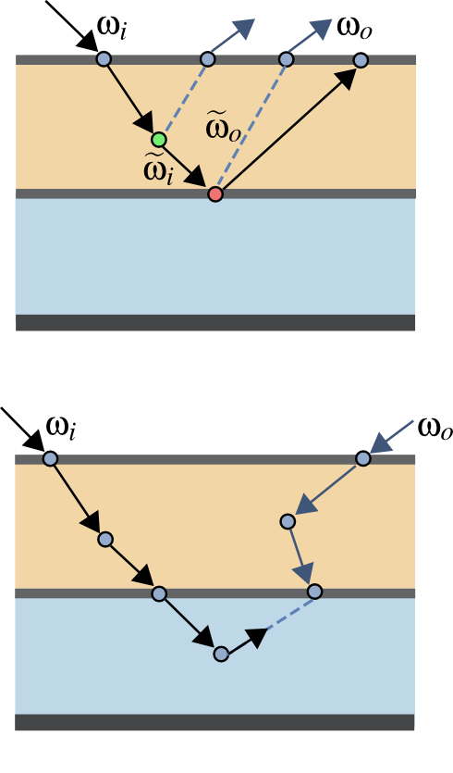


Guo's Unidirectional:
Limited NEE
Nested approach
Severe performance degradation
Guo's Bidirectional:
Connects all paths
Heavy overhead
Notes:
To this end, the state-of-the-art method for layered materials introduced two estimators.
A unidirectional strategy that works on a path starting with the incident direction and makes explicit path vertex connections to a subpath starting in the outgoing direction.
However, their approach cannot make connections to vertices beneath the second interface.
To circumvent this limitation, they proposed a nested approach that prevents them from DOUBLE COUNTING light paths.
But, grouping layers in this way leads to severe performance degradation.

Slide 12
Guo's Unidirectional:
Limited NEE
Nested approach
Severe performance degradation
Guo's Bidirectional:
Connects all paths
Heavy overhead
Notes:
Their bidirectional method, on the other hand, is able to operate on the whole layered structure and can connect all subpaths successfully.
It also outperforms their own nested unidirectional strategy.
However, as a bidirectional method, it still incurs in heavy overhead, as it relies on forward and reverse probabilites, and the associated PDF ratios to correctly combine all strategies.

Slide 13
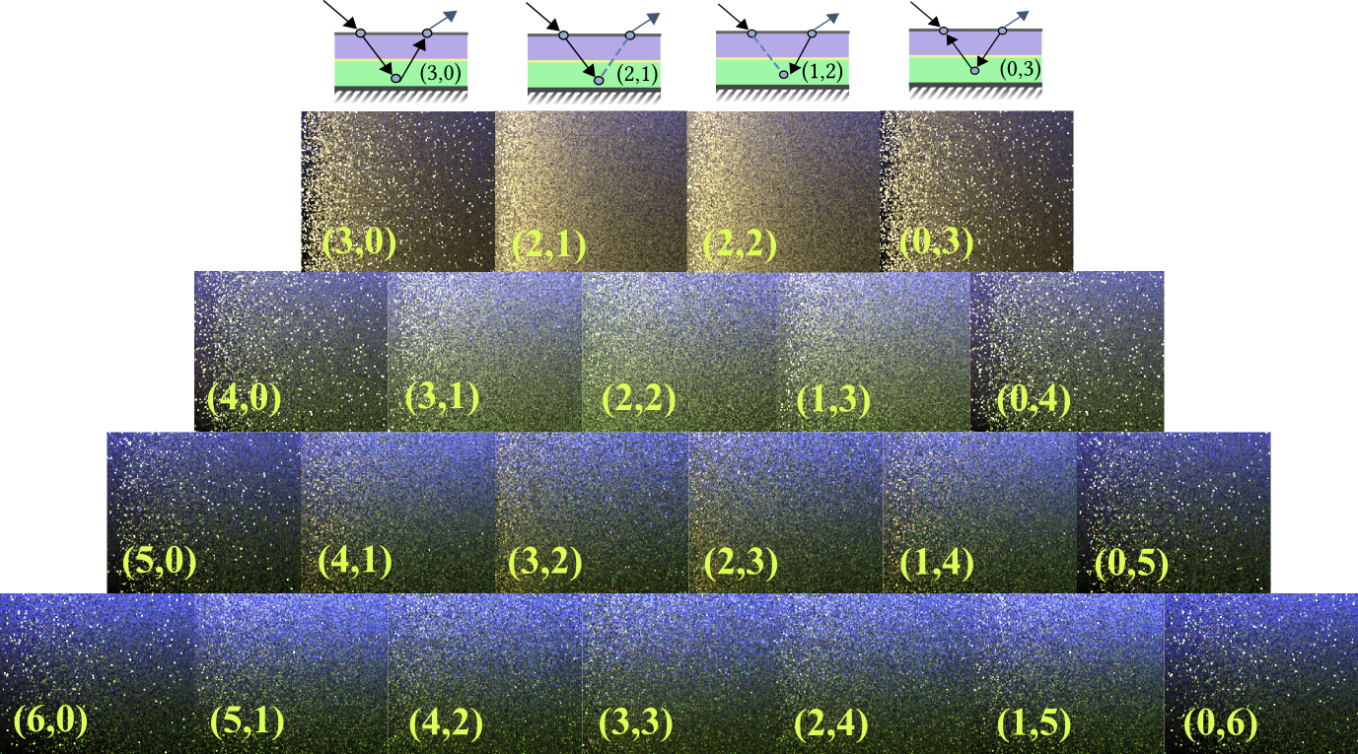
No variance reduction
across the (s,t) sampling strategies
Notes:
But computing all strategies is wasteful.
In this figure we show a parameterized material with varying roughness as well as absorption and scattering coefficients.
We render each bidirectional (s,t) strategy and found that the pyramid is symmetric and there's no benefit from exhaustively exploring all subpath connections since they do not offer variance reduction.

Slide 14
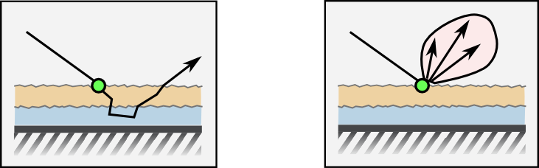
Naive
Dedicated
MIS Weighting
BSDF Sampling
Light Sampling
Notes:
Our solution, like previous work, presents the layered material as a single BSDF allowing us to incorporate it seamlessly in a Monte Carlo -based renderer.
The goal is to prevent the scene level integrator to naively treat the layered structure and instead, provide DEDICATED methods of all the operations required.
For instance, a path tracing integrator with multiple importance sampling, combines BSDF and Light sampling estimators using the equation shown.
Including a layered BSDF, requires to abstract explicitly and efficiently the following operations:

Slide 15
Naive
Dedicated
BSDF Sampling
Light Sampling
Evaluating layered
material
Notes:
for the Light Sampling estimator we need to evaluate the layered material for a fixed pair of view and light directions

Slide 16
Naive
Dedicated
BSDF Sampling
Light Sampling
Sampling layered
material
Evaluating layered
material
Notes:
For the BSDF Sampling strategy we must be able to sample a direction proportionally to the distribution of the layered material as well as computing the associated sampling weight,

Slide 17
Naive
Dedicated
PDF evaluation of the
layered material
BSDF Sampling
Light Sampling
Sampling layered
material
Evaluating layered
material
Notes:
And finally, evaluating the pdf of the material to allow the integrator to compute the MIS weights to blend the BSDF and light sampling strategies.

Slide 18
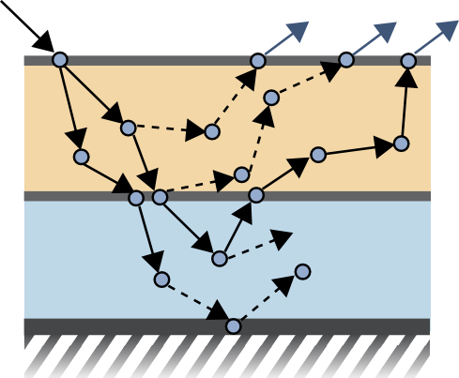
Layered BSDF Evaluation
Path MUST exit with direction
Winning strategy:
  FAST
  LOW VARIANCE
Notes:
To evaluate a layered BSDF, we must estimate the integral over the space of paths that start with direction omega_i and exit the material with direction omega_o.
Our solution offers a low-variance estimate to this integral and is MUCH faster than a full bidirectional method.

Slide 19
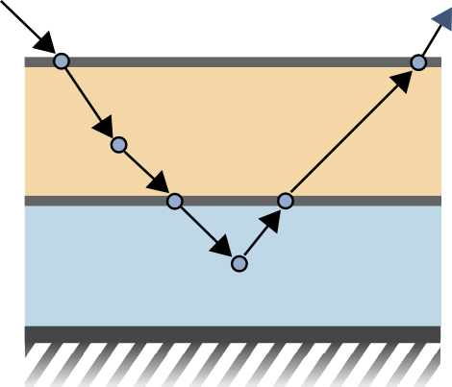
Layered BSDF Evaluation
Trace a path until it leaves the material
Notes:
To this end we first trace a path through the layered material until we exit.
We will reuse this path to progressively compute an estimate to the integral over paths.

Slide 20
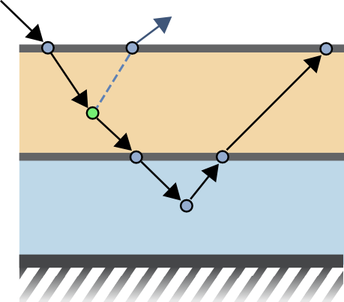
Layered BSDF Evaluation
Trace a path until it leaves the material
Connect vertices to subpath starting at . using NEE
Notes:
The next step is to generate a path starting in the opposite direction that we will also reuse when connecting vertices.
And then for each vertex in the forward direction (in green), we perform an explicit connection using our NEXT EVENT ESTIMATION.
Vertices are either inside the medium

Slide 21
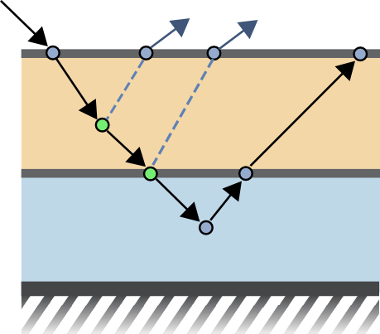
Layered BSDF Evaluation
Trace a path until it leaves the material
Connect vertices to subpath starting at . using NEE
Notes:
Or on an interface

Slide 22
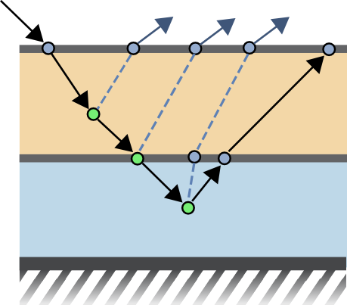
Layered BSDF Evaluation
Trace a path until it leaves the material
Connect vertices to subpath starting at . using NEE
Notes:
One key advantage of our method is that it allows us to make explicit connections to vertices that are occluded by interface layers.

Slide 23
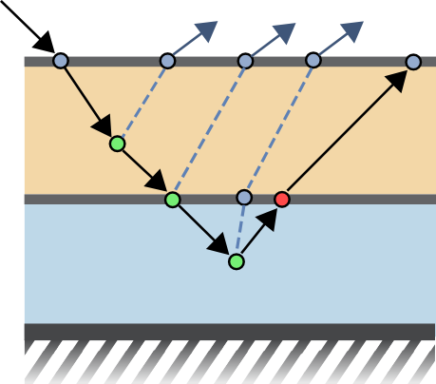
Layered BSDF Evaluation
Trace a path until it leaves the material
Connect vertices to subpath starting at . using NEE
Do not connect vertices:
      on an interface
      connects to the subpath
      requires a transmission event
Notes:
However, in doing so, we must be careful to not connect certain vertices that lead to double counting path throughput contributions.
We identify this class of vertices, when they conform with the following three criteria:
- first, the vertex is located on an interface,
- second, that interface connects to the path arriving from the opposite direction,
- and, third, the connection requires a transmission event across the interface.

Slide 24
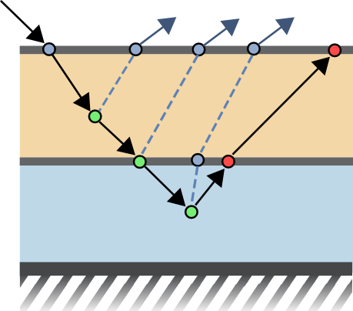
Layered BSDF Evaluation
Trace a path until it leaves the material
Connect vertices to subpath starting at . using NEE
Do not connect vertices:
      on an interface
      connects to the subpath
      requires a transmission event
Notes:
In this example only two vertices were not connected.
They can be interpreted as residing on an emitter and the next-event estimations as performing explicit path tracing.
Adding the emission of such vertices yields an incorrect result, since emission has already been accounted for previously as direct illumination.

Slide 25
Layered BSDF Sampling
Trace a path until it leaves the material
Sampled direction
  → exit direction
Sampling weight (eval/pdf)
  → path throughput
Notes:
The sampling operation is straightforward.
In this case, with initial direction omega_i, we generate a path through the layered material by importance sampling the associated phase function or BSDF at each scattering event.
There's no need to store path information as we are only interested in data for the last vertex.
Once the path exits the material, the outgoing direction is the requested sample and the path throughput is the sampling weight.
This approach provides an importance sampling strategy for the layered material with the additional advantage of including the exact PDF of the sampled direction in the path throughput without any extra operations.

Slide 26
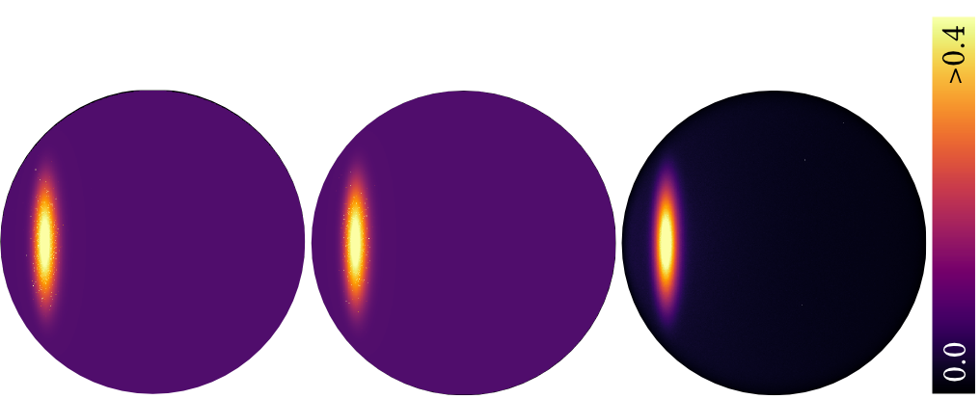
Layered BSDF PDF estimation
Similar to evaluation
Used only for top level MIS
Approximation
Guo et al. 2018
Ours
Speedup: 1.74x
True PDF
Notes:
Evaluating the PDF of an outgoing direction given an incoming direction is a similar problem to evaluating the layered material for a pair of directions.
However, this estimate will be used exclusively for computing MIS weights to combine unbiased BSDF and light sampling strategies.
We take advantage of this and approximate the estimate by omitting scattering in participating media and restricting the maximum path length.
Additionally, we use our unidirectional estimator with importance sampling connections.
Our results converge to the same shape as the state-of-the-art, albeit being almost twice as fast with roughly the same variance noise.

Slide 27
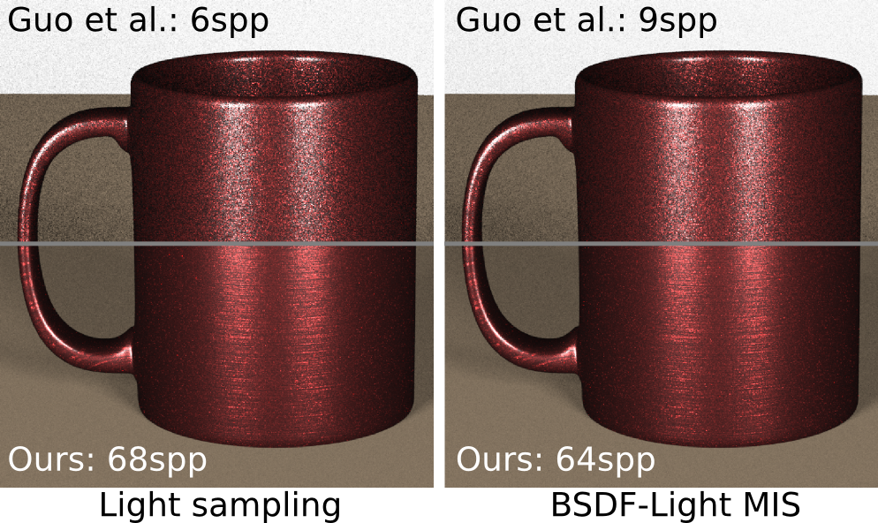
Speedup of 7-11x in equal-time
Notes:
The performance gains of our evaluation method can be isolated by comparing render times of direct illumination using only the light sampling strategy.
Here we show two comparisons at equal-time.
On the left, we render using exclusively light sampling, and all the differences in performance rely on the cost of evaluating the layered material.
Under this setup, our method renders 11 times more samples per pixel.
On the right, we render direct illumination using MIS for BSDF and light sampling.
In these conditions, performance depends on all three material operations, and our method generates 7 times more samples per pixel.

Slide 28
Speedup of 7-11x in equal-time
Speedup of 2-6x
for equal-quality
Notes:
We observed consistent speed ups in reaching equal-quality, under global illumination, that ranged from a factor of 2 to 6, depending on the scene.

Slide 29
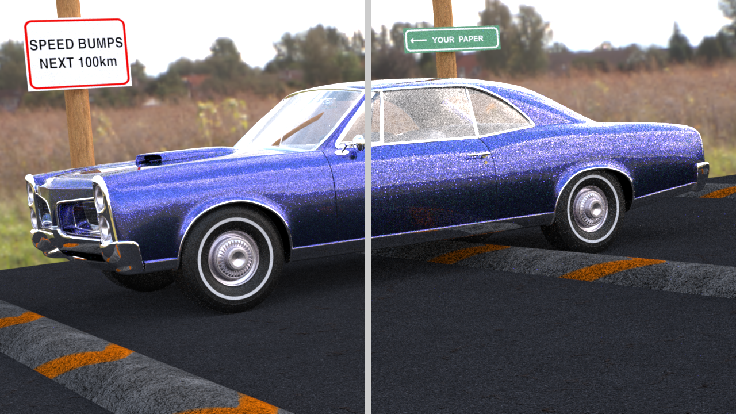
Ours
[Guo et al. 2018]
Notes:
In this scene, we compare side by side at equal time with the state-of-the-art.
The speedup factor in sample cost is about 3.5,
with a factor for equal-quality at 3.3

Slide 30
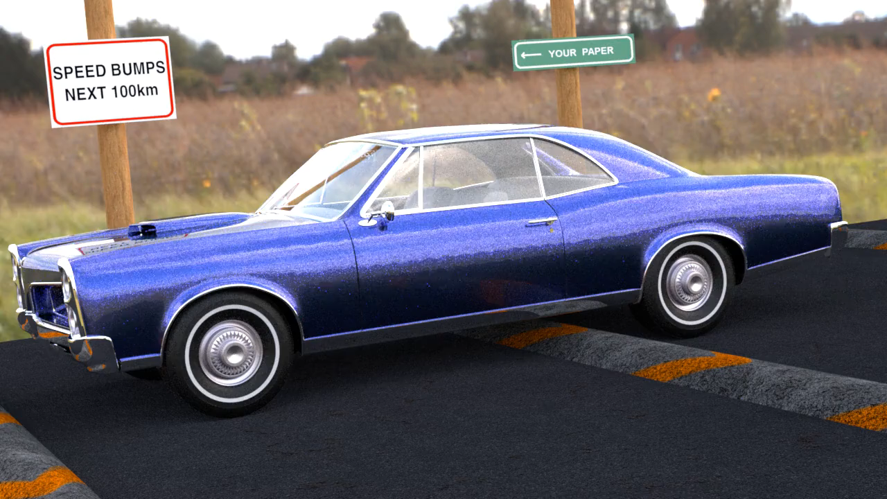
Notes:
We show a video sequence of our method where each frame takes roughly 30 seconds to render using 256 samples per pixel.
In the same time the method by Guo and colleagues manages only 74 samples per pixel.

Slide 31
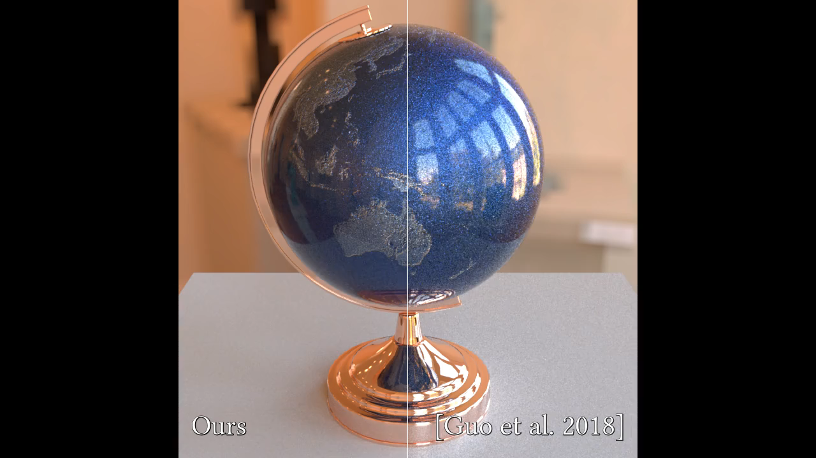
Notes:
We compare at equal-time using the Globe scene from Guo and colleagues, with an average of 28 seconds per frame.
Our method is able to render 384 samples per pixel and the state-of-the-art 76.
When aiming for equal-quality, our method is four times faster.

Slide 32
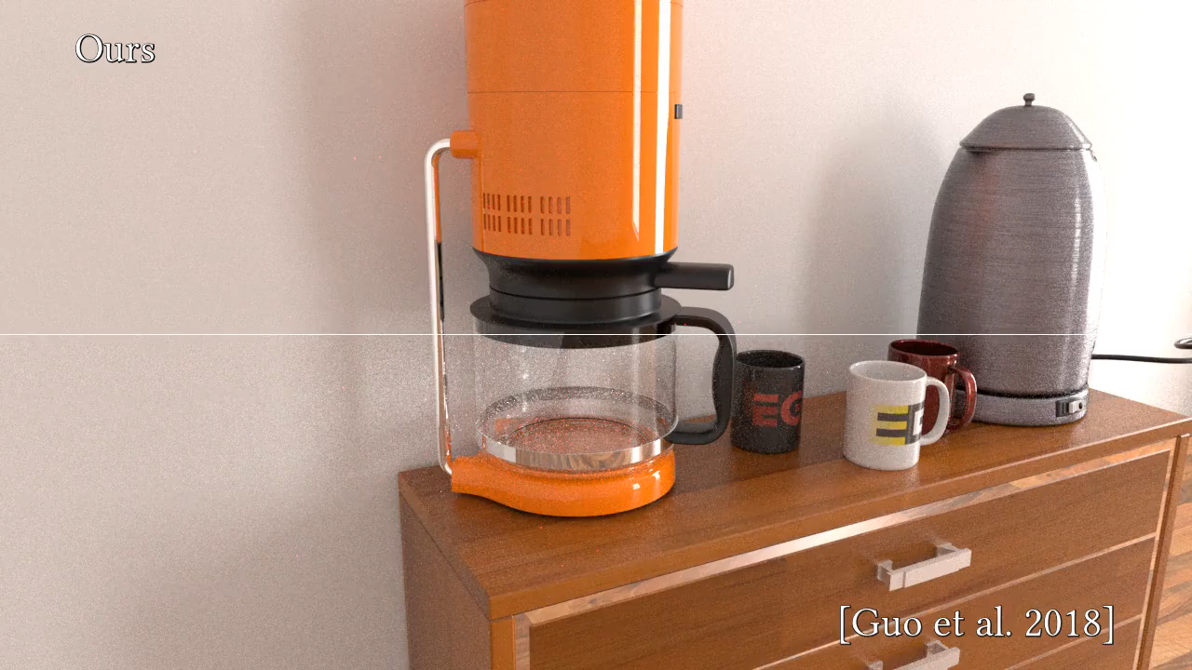
Notes:
Our coffee table scene presents a collection of different layered materials with spatially varying properties.
In this scene, each frame took an average of 8 minutes to render.
For this particular setup, our method is two times faster in reaching equal-quality.

Slide 33
Complex layered materials
Position-free formulation
Unidirectional with NEE
Significant speedups
Notes:
This work introduced an efficient method for rendering complex layered materials.
By leveraging the position-free formulation, we proposed a unidirectional strategy with an improved next-event estimation method that achieves significant speedups over the state-of-the-art in reaching equal-quality.

Slide 34
Thanks
Notes:
Thank you for watching

