Slide 1

3.2 COMPUTER FUNCTION

Slide 2
COMPUTER FUNCTION
Computer Function
The basic function of a computer is the execution of a program, which consists of a set of instructions stored in memory.
The processor does the actual work, by executing instructions specified by the program.

Slide 3
Instruction Cycle
Computer Function
Instructions processing, consists in two steps:
The processor reads (fetches) instructions from memory one at a time (fetch cycle).
The processor executes each instruction (execute cycle).
Program execution consists of repeating this process.

Slide 4
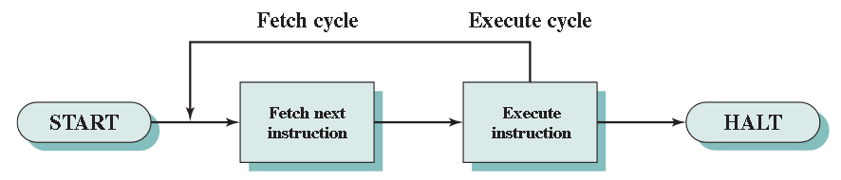
Instruction Cycle Diagram
Computer Function

Slide 5
Instruction Fetch and Execute
Computer Function
For each instruction cycle, the processor fetches an instruction from memory.
In a typical processor, a register called program counter (PC) holds the address of the instruction to be fetched next.
The PC is incremented after each instruction fetch.

Slide 6
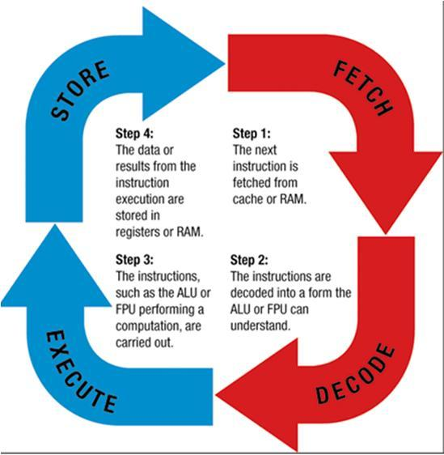
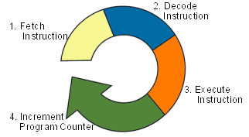
Computer Function
The fetched instruction is loaded into a register in the processor known as the instruction register (IR), storing the action the processor is to take.
The processor interprets the instruction and perform the required action.

Slide 7
Computer Function
The actions to be taken by the processor falls in one of 4 categories:
Processor-Memory: Data transferred from processor to memory or from memory to processor.
Processor-I/O: Data transferred from or to a a peripheral device.
Data processing: Processor performs some arithmetic or logic operation on data.
Control: An instruction may specify that the sequence of execution be altered.

Slide 8
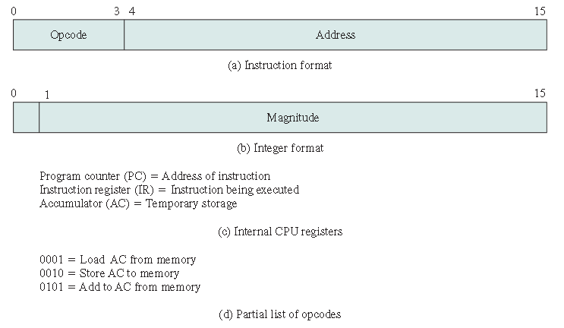
Example
Computer Function

Slide 9
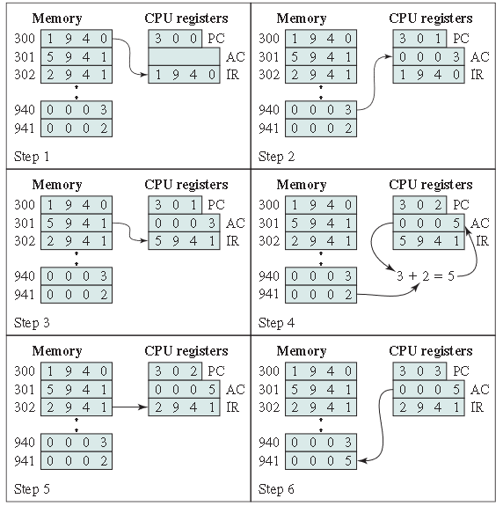
Computer Function
The program fragment shown adds the contents of the memory word at address 940 to the contents of the memory word at address 941 and stores the result in the later location.

Slide 10
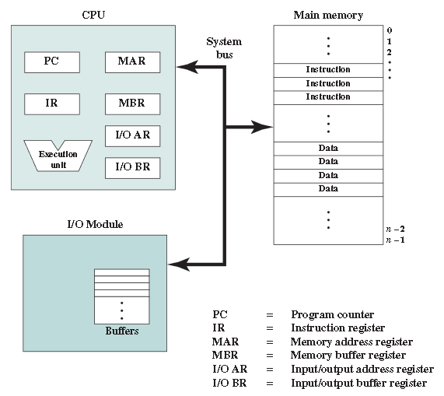
Computer Function

Slide 11
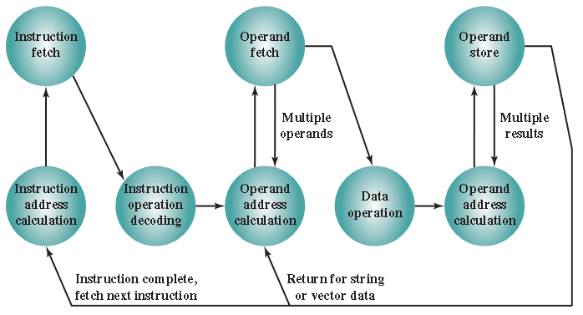
Instruction Cycle State Diagram
Computer Function
The execution cycle for a particular intruction may involve more than one reference to memory or may specify an I/O operation.

Slide 12
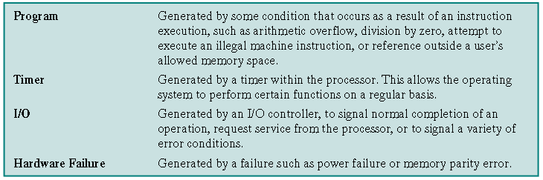
Interrupts
Computer Function
Virtually all computers provide a mechanism by which other modules (I/O, memory) may interrupt the normal processing of the processor.

Slide 13
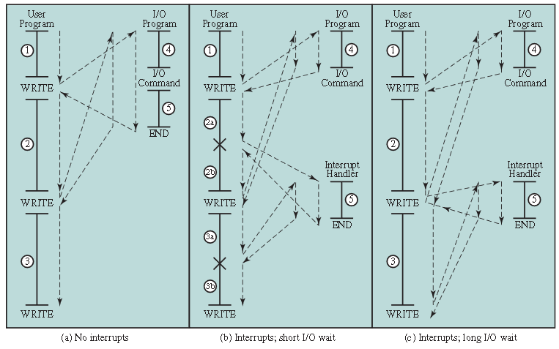
Computer Function

Slide 14
Computer Function
The I/O program consists of three sections:
A sequence of instructions, labeled 4 in the figure, to prepare for the actual I/O operation.
The actual I/O command. Without the use of interrupts, once this command is issued, the program must wait for the I/O device to perform the requested function (or periodically poll the device).
A sequence of instructions, labeled 5 in the figure, to complete the operation.

Slide 15
Computer Function
In the figure the user program performs a series of WRITE calls interleaved with processing (code segments 1, 2, and 3). The WRITE calls are to an I/O program that is a system utility and that will perform the actual I/O operation.

Slide 16
Interrupts and the Instruction Cycle
Computer Function
With interrupts, the processor can execute other intructions while an I/O operation is in progress.
The I/O program that is invoked consists of the preparation code and the actual I/O command. After executing these instructions, control returns to the user program, meanwhile de external device is accepting data from computer memory and printing it.

Slide 17
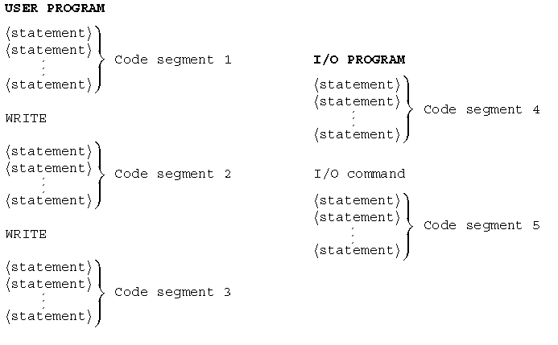
Computer Function
When the external device becomes ready to be serviced the I/O module sends an interrupt request signal to the processor. The processor suspends operation of the current program, branching off to a program to service that particular I/O device, known as an interrupt handler, and resuming the original execution after the device is serviced.

Slide 18
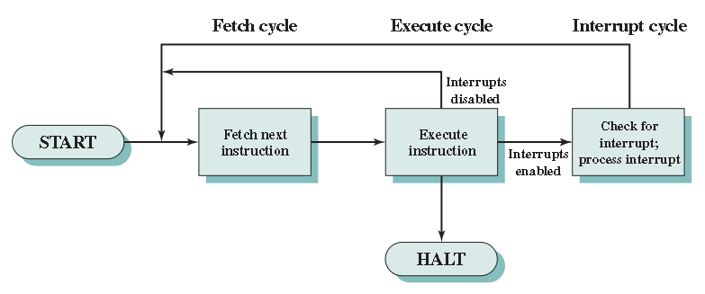
Computer Function
To accommodate interrupts, an interrupt cycle is added to the instruction cycle.

Slide 19
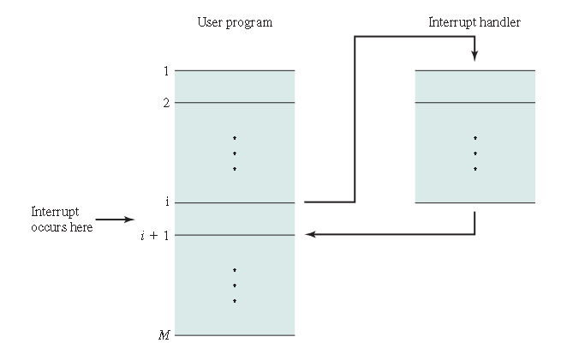
Computer Function
If an interrupt occurs the processor does the following:
It suspends execution of the curren program being executed and saves the address of the next instruction and data relevant to the current process.
It sets the PC to the starting address of a interrupt handler routine.

Slide 20
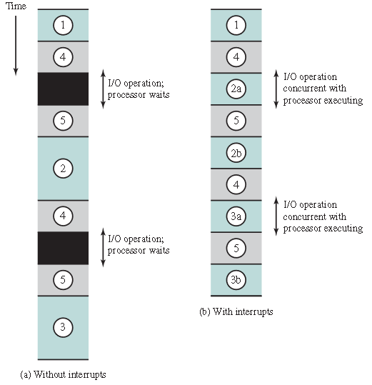
Computer Function
To appreciate the gain of efficiency, consider the next timing diagram based on the flow control in figures (a) and (b).
User program code segments are shaded green.
I/O program code segmends are shaded gray.

Slide 21
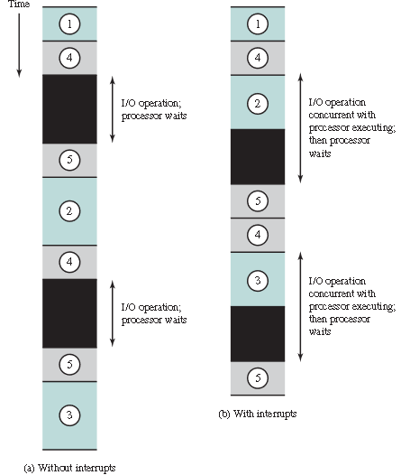
Computer Function
Last figure (b) assumes that time required for the I/O operation is relatively short.
The more typical case, is that the I/O operation will take much more time executing a sequence of user instructions.

Slide 22
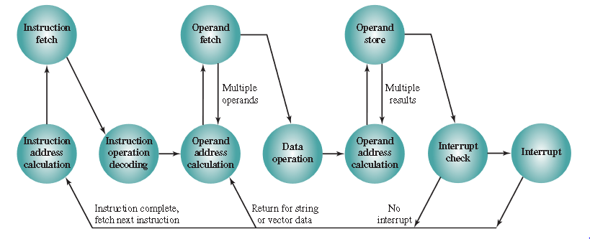
Revised Instruction Cycle State Diagram
Computer Function

Slide 23
Multiple Interrupts
Computer Function
Two approches can be taken when multiple interrupts occur.
Sequential interrupt processing: The processor can and will ignore an interrupt request signal. The interrupt remainds pending and will be checked by the processor once the it has enabled interrupts.
Nested interrupt processing: An interrupt service routine (ISR) with higher priority can cause a lower-priority interrupt handler to be itself interrupted. A ISR with lower-priority is simply held.

Slide 24
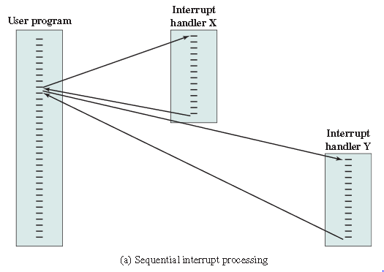
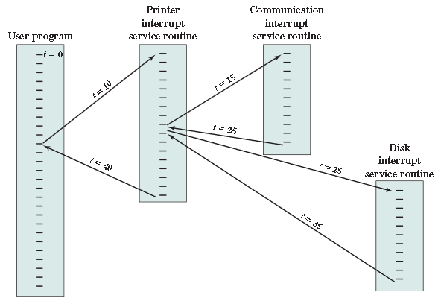
Computer Function
(a) Sequential interrupt processing (b) Nested interrupt processing

